Slide 1
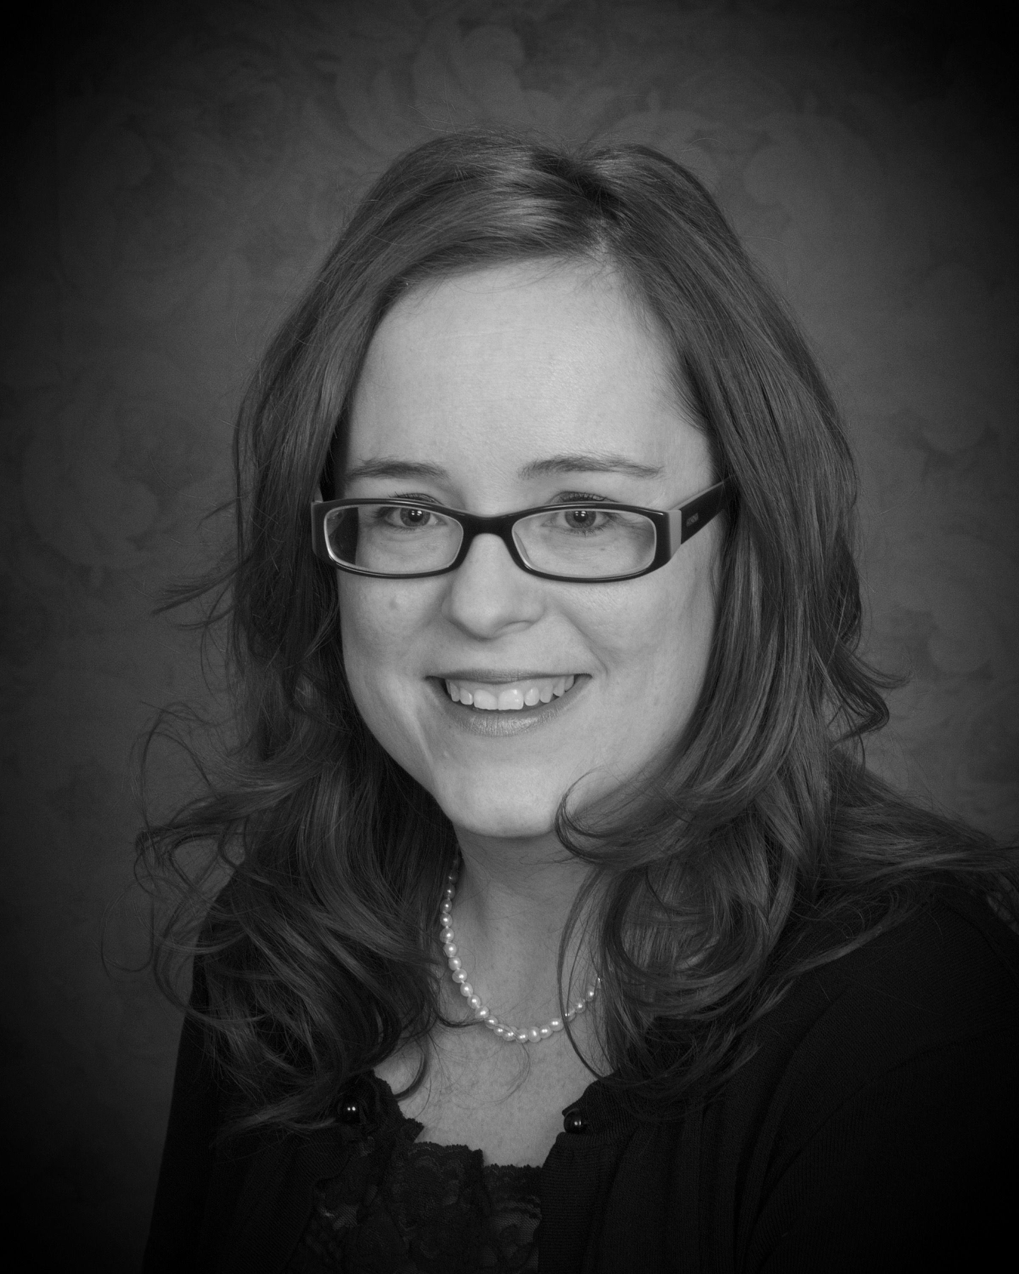
FACILITATOR
MALISSA YOUNG
MaLissa Young serves SSBC as a shareholder, facilitator and Summit Salon Consultant. She holds a full cosmetology license, has worked as a nail technician and nail educator. She has experience in multi-location salons, and has assisted many salons growth from
$20k/mo to $90k /mo.
MaLissa is fulfilling her passion of coaching others to achieve their goals with creative style of making a system work for every personality type.
DATE: February 17, 2020
TIME 7 PM – 9 PM
:
LOCATION:
State Beauty Supply
1216 Fleming St
Garden City, KS 67846
INVESTMENT: $19.95 non refundable
*Receive free gift at the event valued between $25.00-$40.00
CODE: sal21720gc
TO REGISTER:
1-800-234-0524
*Must attend event to receive gift

